Slide 1
GraphQL with Apollo

Slide 2




Peter Eijgermans
@EijgermansPeter

Slide 5
Notes:
Facebook's mobile apps have been powered by GraphQL since 2012.
A GraphQL spec was open sourced in 2015.

Slide 6
Notes:
Het bouwen van een interactieve app om je plek te reserveren voor een aankomende Space-X-lancering.
Alle gegevens zijn echt, dankzij de SpaceX API.
https://www.apollographql.com/docs/images/space-explorer.png
De app heeft vijf schermen: een inlogscherm, een lijst met lanceringen, een startdetail, een profielpagina en een winkelwagentje.
De grafische API die onze Space-app van stroom voorziet, maakt verbinding met een REST-API en een SQLite-database.
We behandelen essentiële onderwerpen zoals: authenticatie, paginering, testen en implementatie.

Slide 7
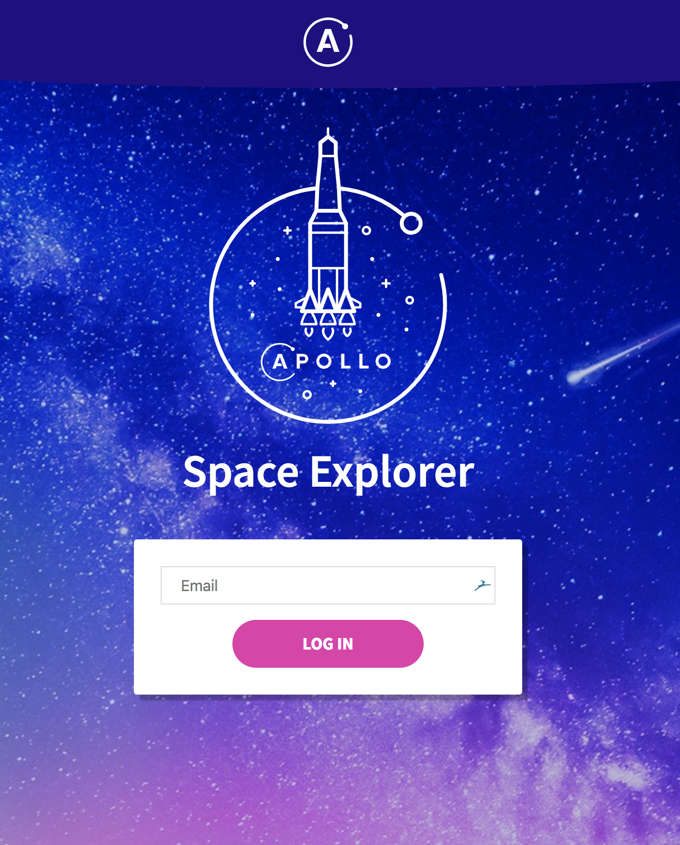

Slide 8
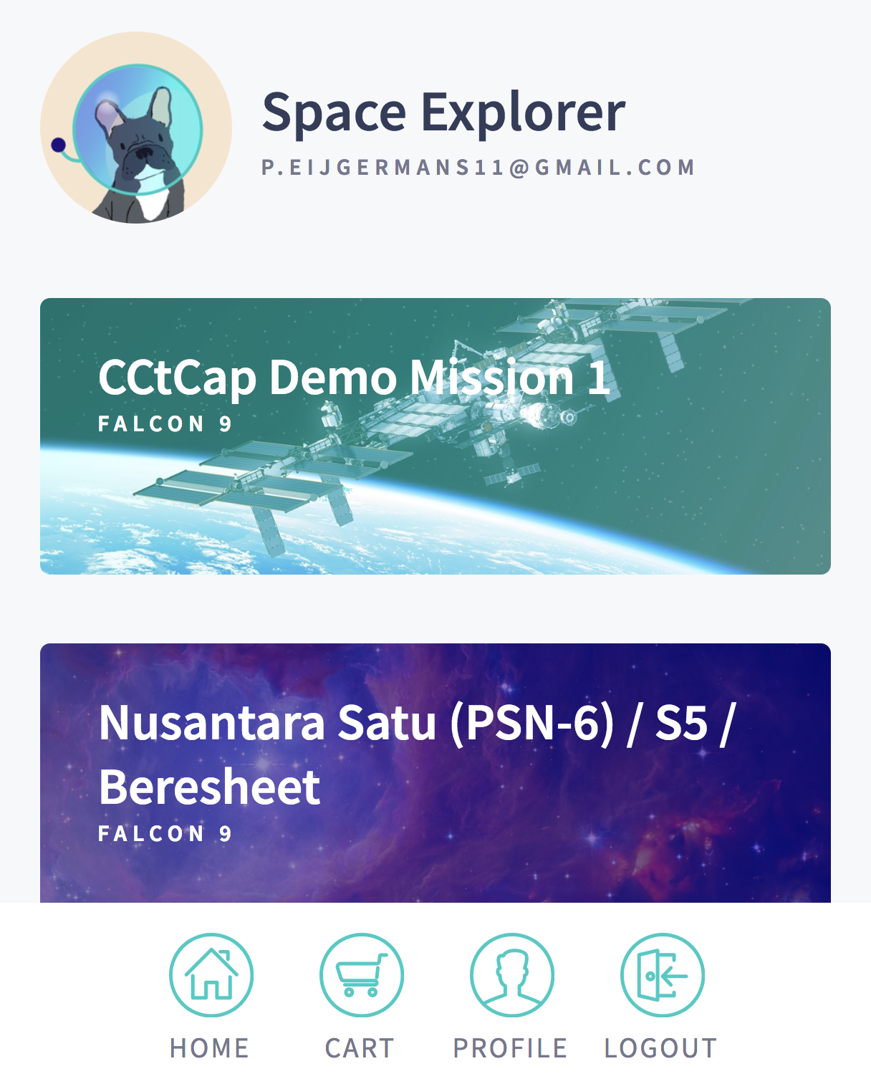

Slide 9
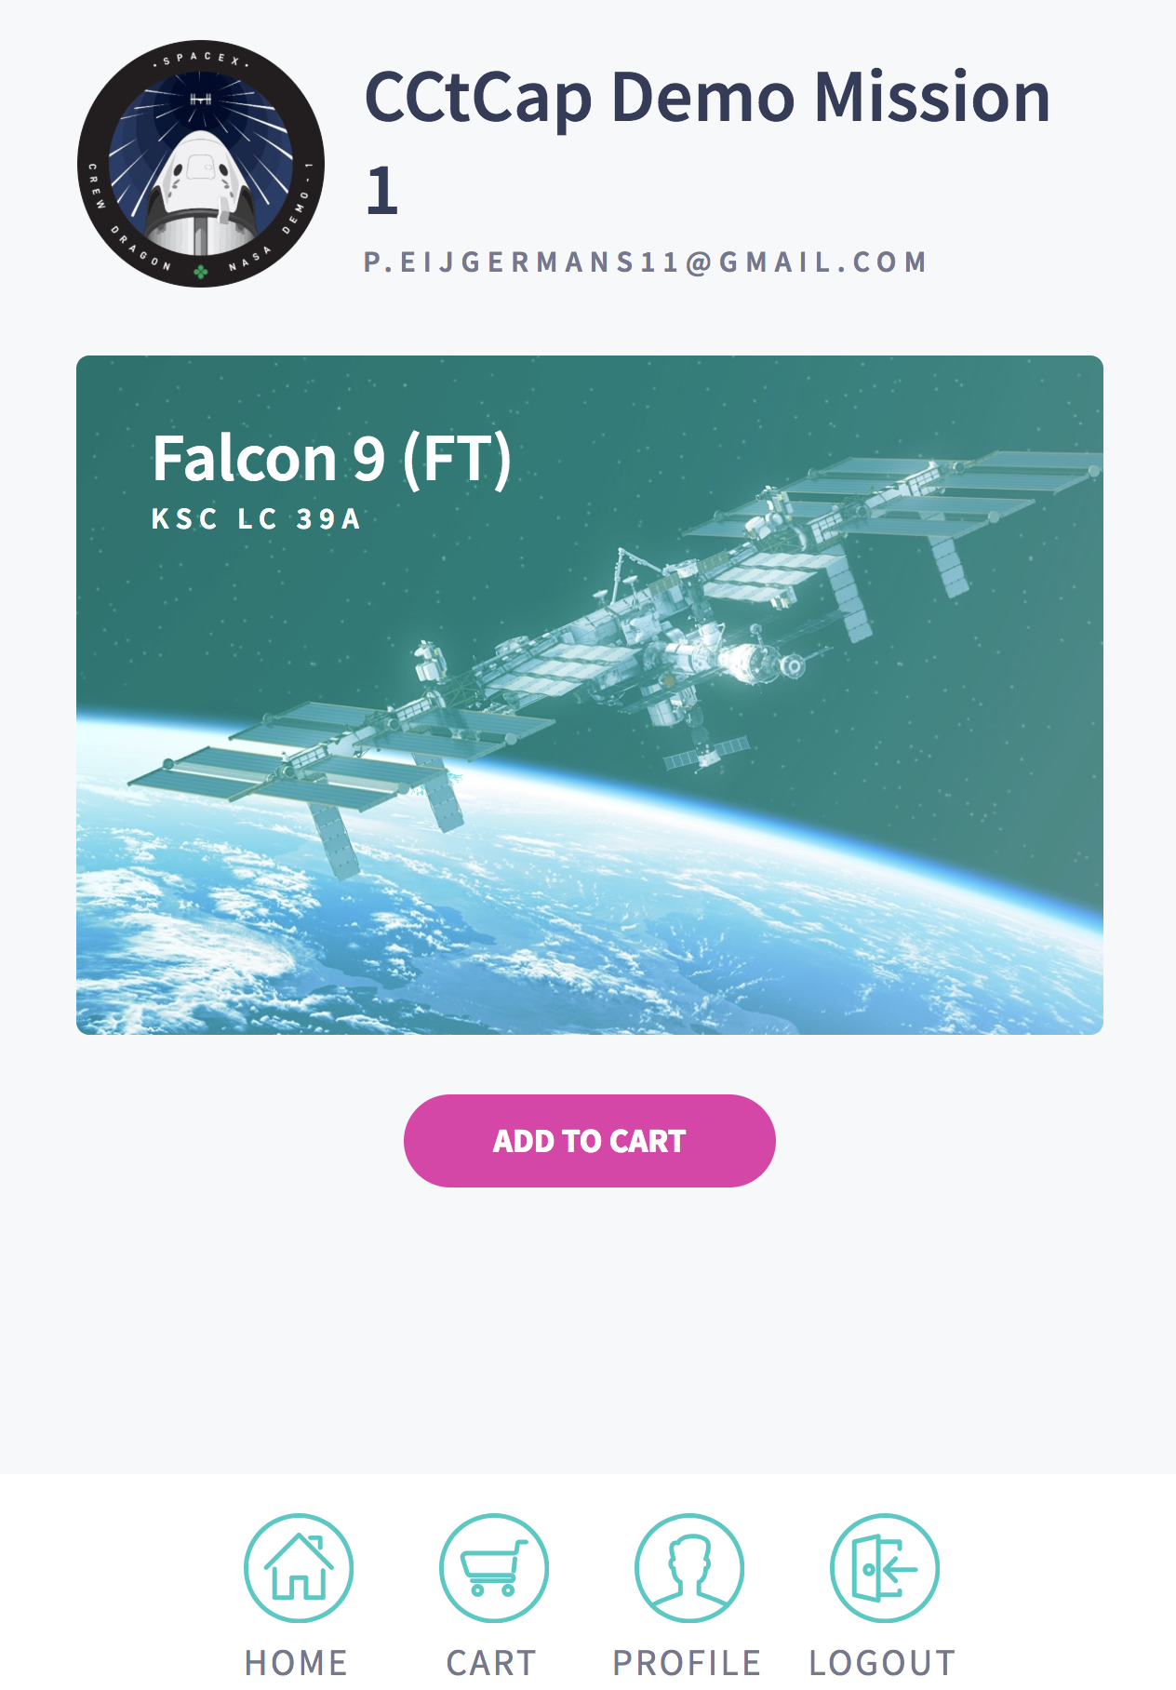

Slide 10
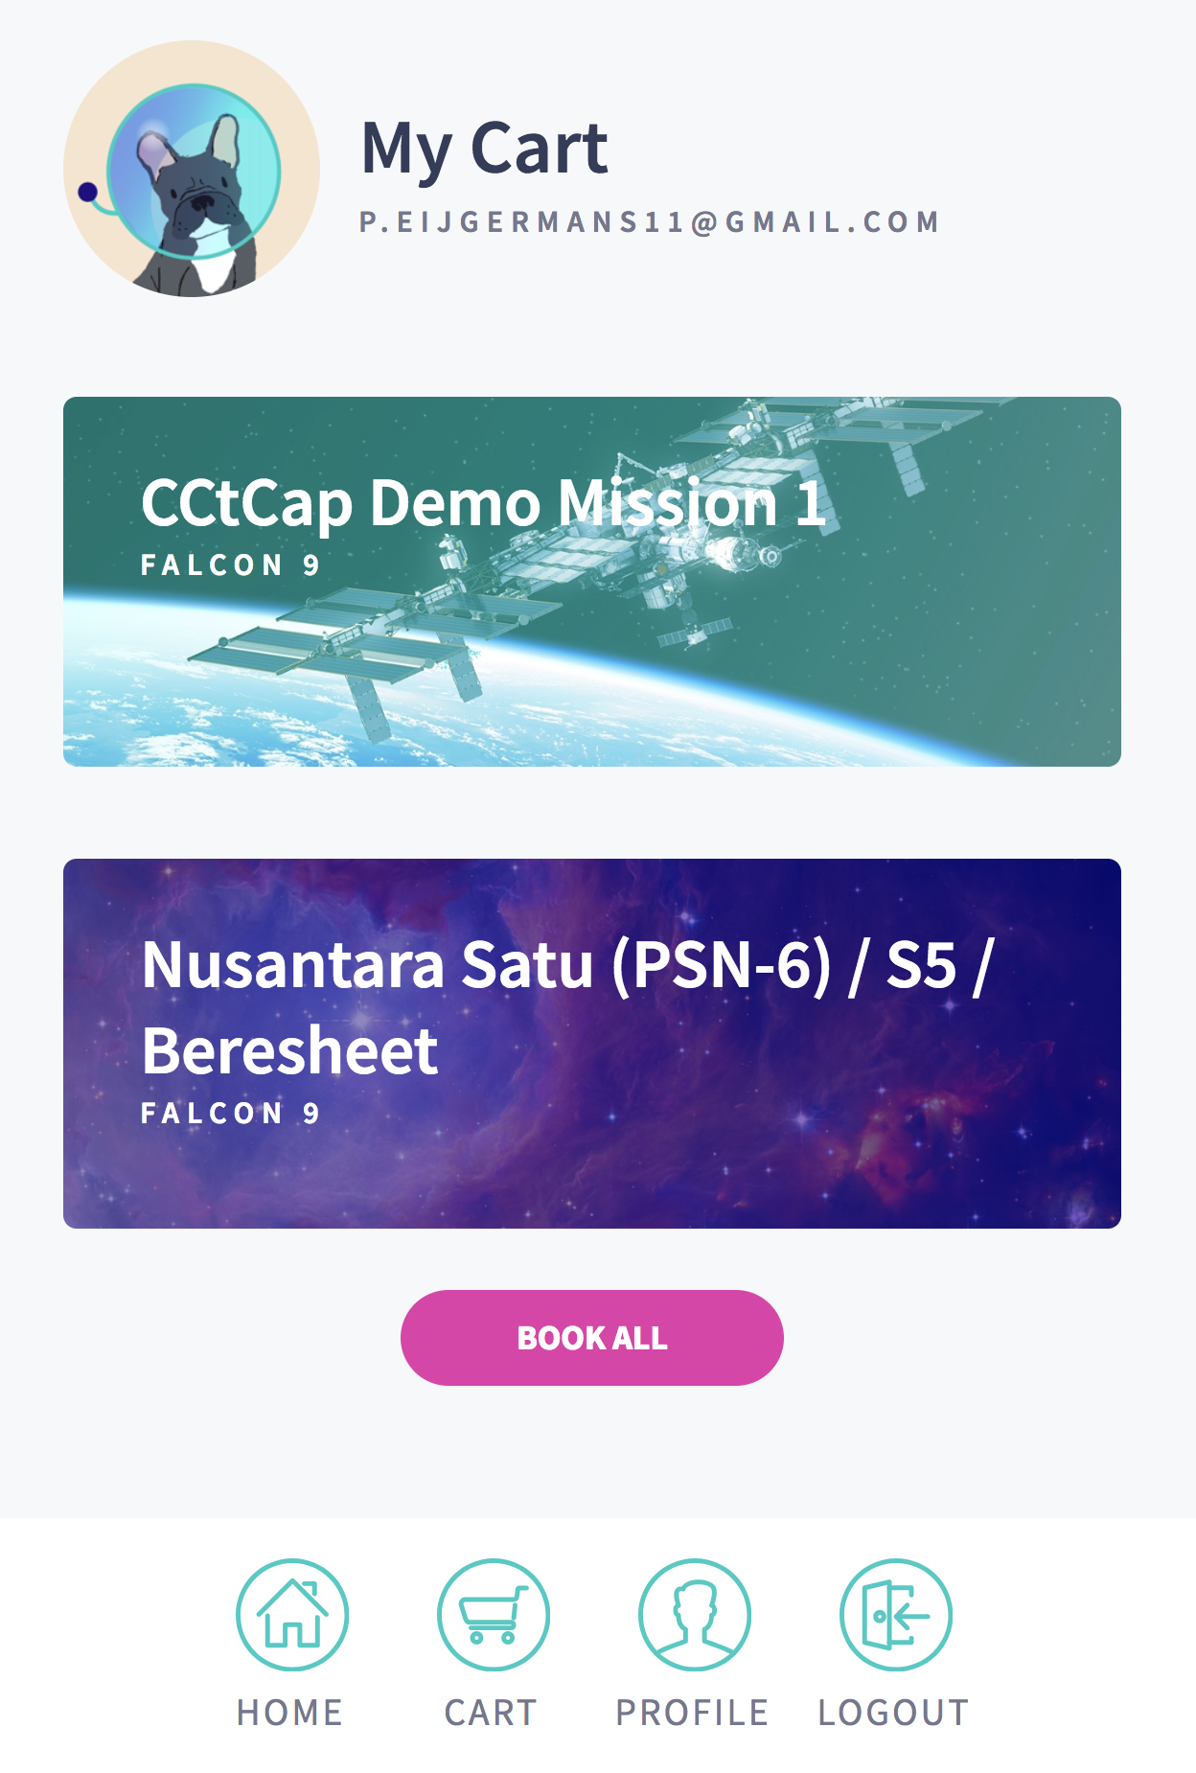
Notes:
Book SPACE-X lancering

Slide 11
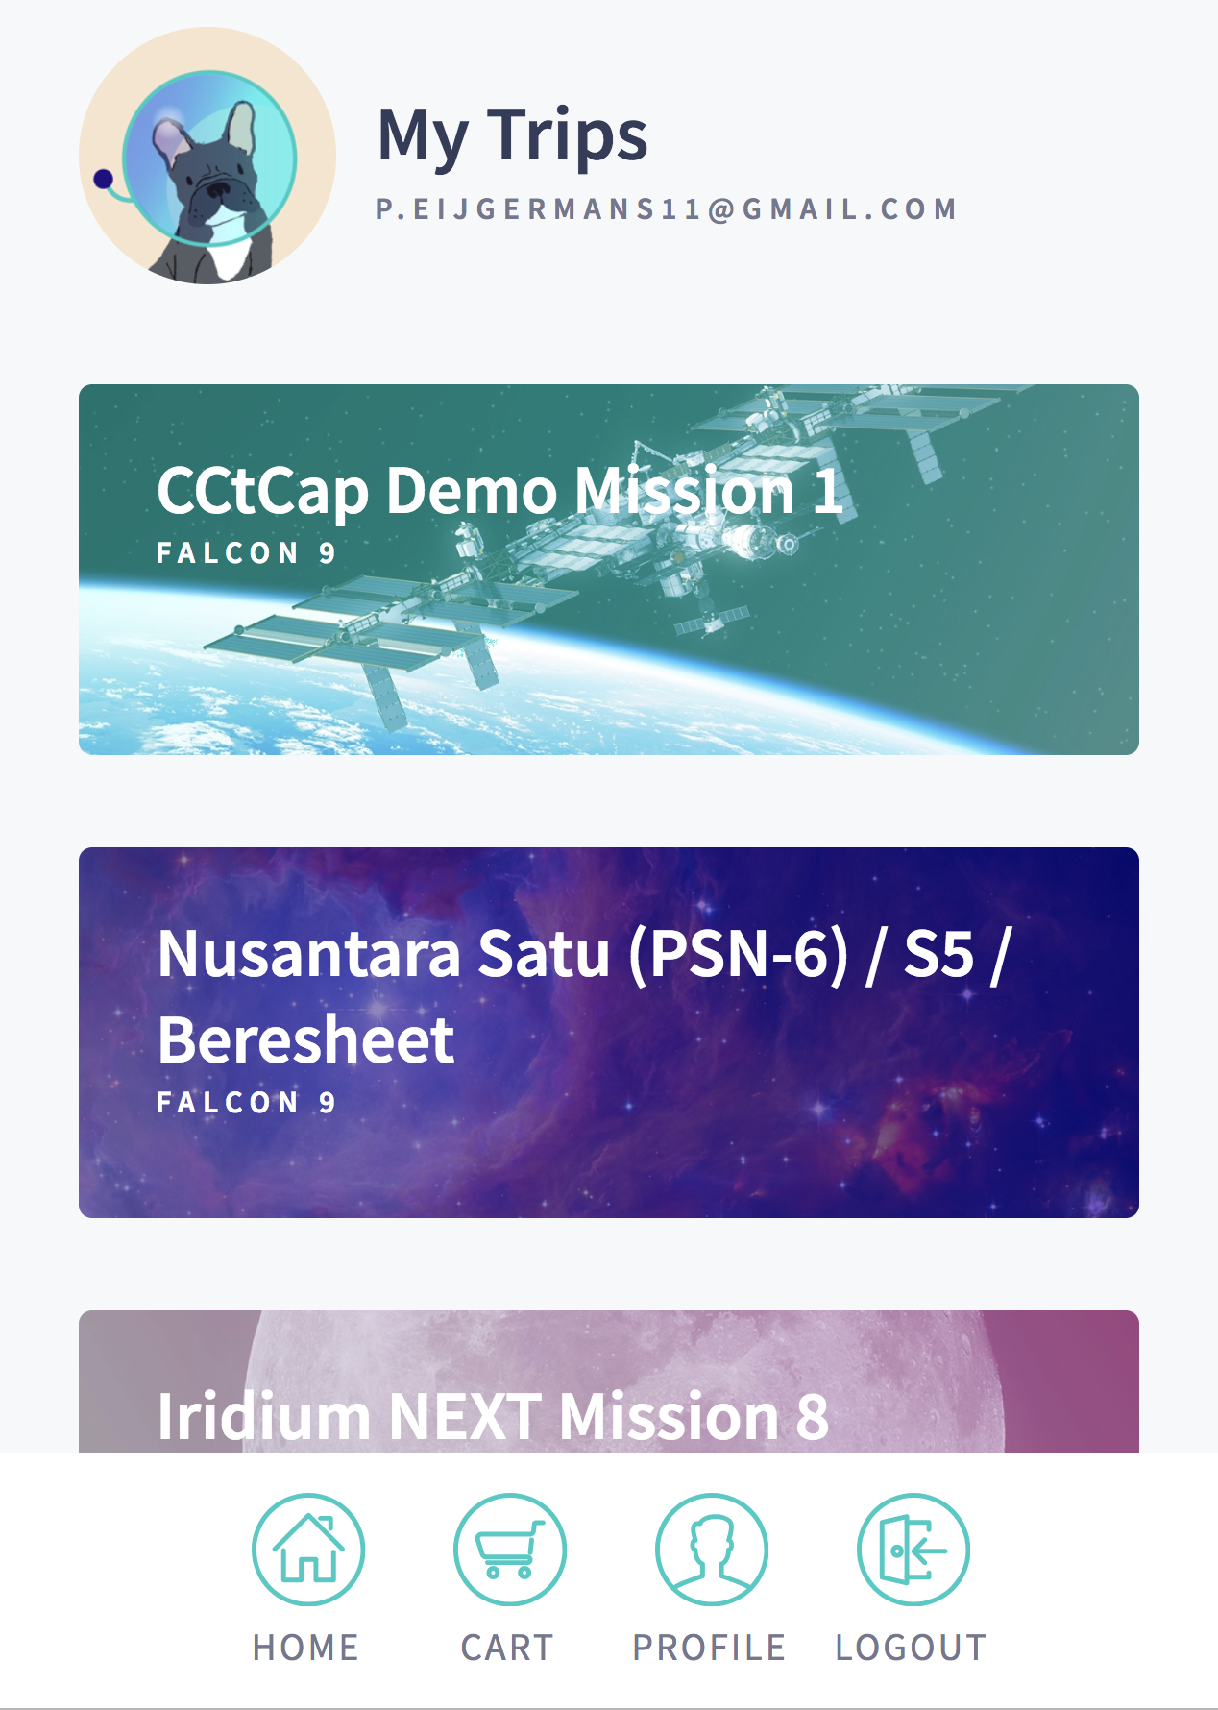

Slide 12
Prerequisites
System requirements
Before we begin, make sure you have:
Node.js v6.9.0 or greater
npm 3.10.8 or greater
git v2.14.1 or greater
Visual Studio Code installed

Slide 13
Next, in your terminal, clone this repository:

Slide 14
Notes:
APOLLO SERVER: HIER BOUW JE EEN API volledig afgestemd VOOR JE CLIENT
API = SCHEMA
GRAPHQL = execute queries
------
APOLLO SERVER: HIER DEFINIEER JE HET SCHEMA (= MODEL) VOOR ALLE UITGAANDE REQ en BINNENKOMENDE RESPONSES
https://www.apollographql.com/docs/apollo-server/
Apollo GraphQL Server:
Apollo Server is the best way to quickly build a API for GraphQL clients.
It is incrementally adoptable and can be layered over your existing services, including REST APIs and databases.
apollo-server: The Apollo server library which allows you to focus on defining the shape of your data (via a schema) and how to fetch it.
graphql: The library used to build a schema and to execute queries on that schema.
Apollo Client:
Jeroen Verhoeven gaat dit morgen behandelen.
Apollo Client: manages data and state in an application.

Slide 15
Where do GraphQL and Apollo live?

Slide 16
Apollo Client
Trigger queries as part of UI components;
Binding query results to the UI
Caching
State management (no Redux needed !)
Integrations for React, React Native, Vue, Angular ect.

Slide 17
Apollo Server
Defining a generic API = schema (model) for the client
API layered over your existing services, including REST APIs and databases
Improved Performance → smaller payload
Caching
Notes:
Since the response back from the server contains only the properties you specify in your query, GraphQL can significantly reduce payload size compared to a REST endpoint. L

Slide 18
Why GraphQL?

Slide 19
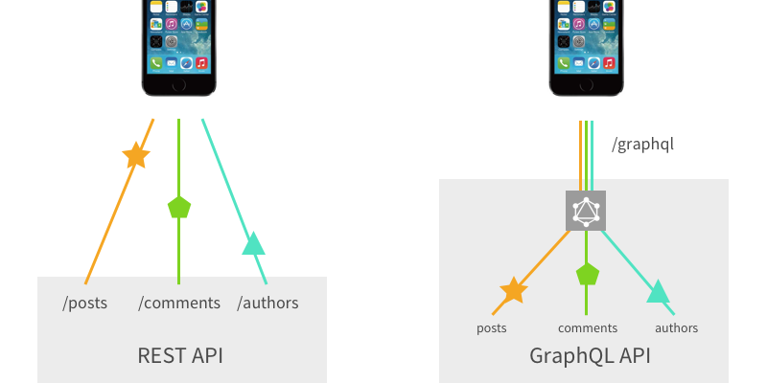
Get many resources in a single request
Notes:
Different: In REST, the endpoint you call is the identity of that object. In GraphQL, the identity is separate from how you fetch it.
Different: In REST, the shape and size of the resource is determined by the server. In GraphQL, the server declares what resources are available, and the client asks for what it needs at the time.
GraphQL request returns only one response!!!

Slide 20
Notes:
REST: API gedefinieerd aan server zijde
GRAPHQL: API gedefinieerd aan de client zijde + afgestemd op de client

Slide 21
3 Steps to build GraphQL API
Step 1: Build a schema = API
Step 2: Hook up your data sources
Step 3: Write your graph’s Resolvers
Notes:
Since a schema sits in between your clients and your underlying services, it serves as a perfect middle ground for frontend and backend teams to collaborate.

Slide 22
Step 1: Build a schema = API
A GraphQL schema is the center
of any GraphQL server

Slide 23
Our schema will be based on these features:
Queries
Fetch all upcoming rocket launches
Fetch a specific launch by its ID
Mutations
Book launch trips if the user is logged in
Cancel launch trips if the user is logged in
Login the user

Slide 24
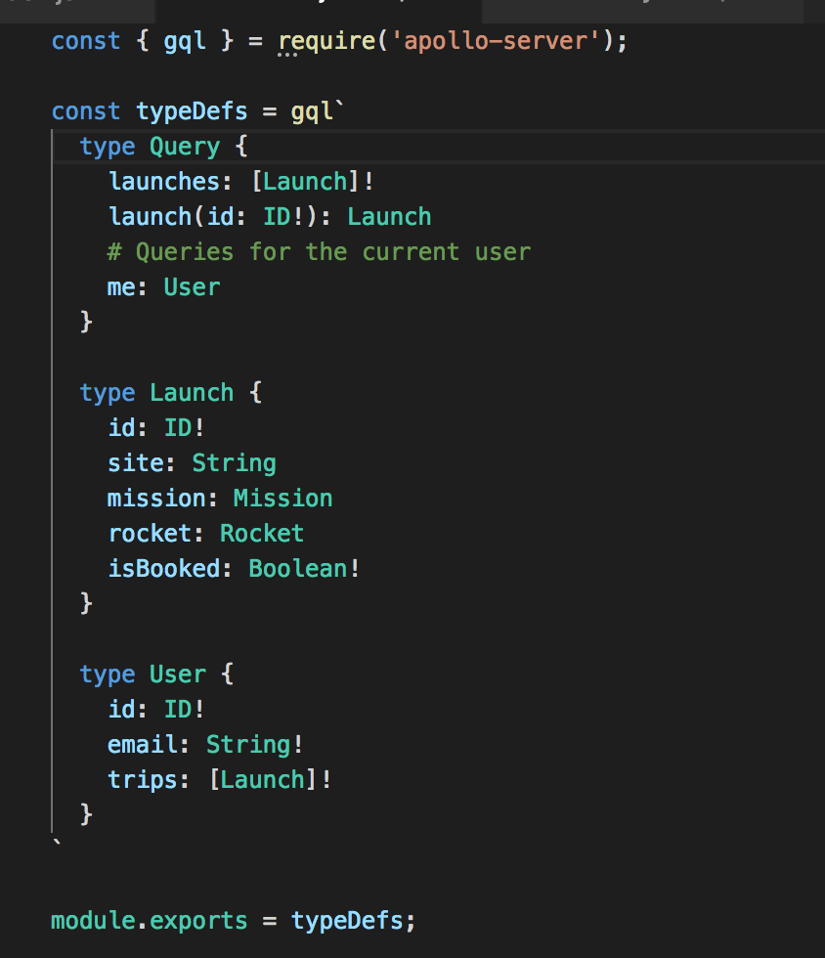
schema.js
Notes:
What’s awesome about GraphQL is that the shape of your query will match the shape of your response.
A schema also defines what data we can fetch through queries
and what data we can update through mutations
Since all types in GraphQL are nullable by default, we need to add the ! to indicate that our query will always return data.
Next, we define a query to fetch a launch by its ID. This query takes an argument of id and returns a single launch.
Finally, we will add a me query to fetch the current user's data.

Slide 25
What’s awesome about GraphQL
The shape of your query will match the shape of your response.

Slide 26
Our schema will be based on these features:
Queries
Fetch all upcoming rocket launches
Fetch a specific launch by its ID
Mutations
Book launch trips if the user is logged in
Cancel launch trips if the user is logged in
Login the user

Slide 27
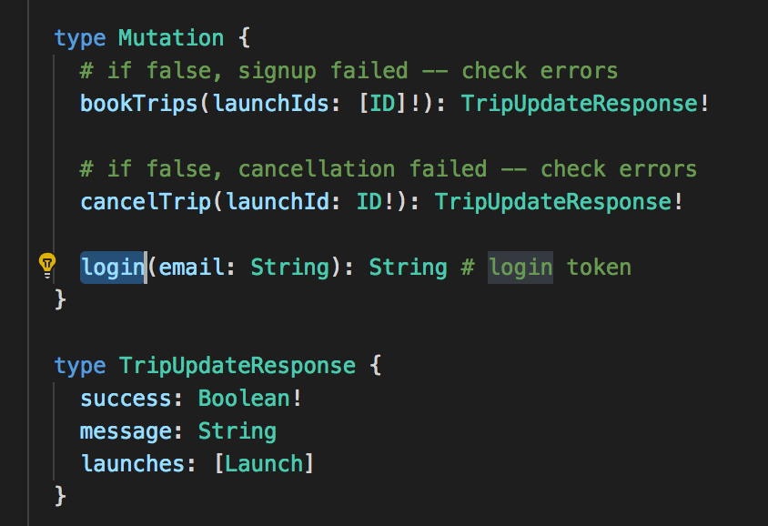
Mutation (schema.js)

Slide 28
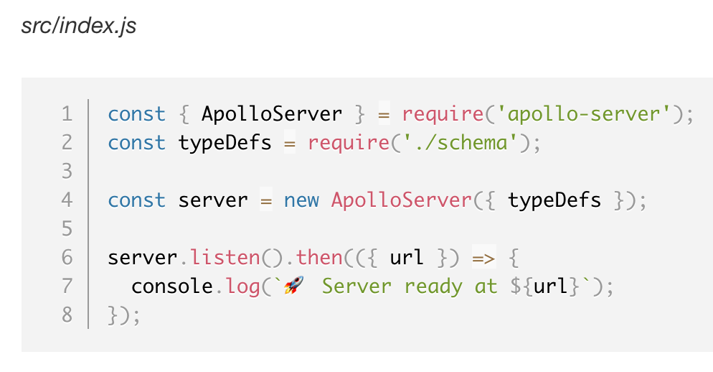
Define your Apollo server + npm start
Notes:
Apollo Server is a library that helps you build a graph API over your data. It can connect to any data source, including REST APIs and databases
Apollo Server will now be available on port 4000.

Slide 29
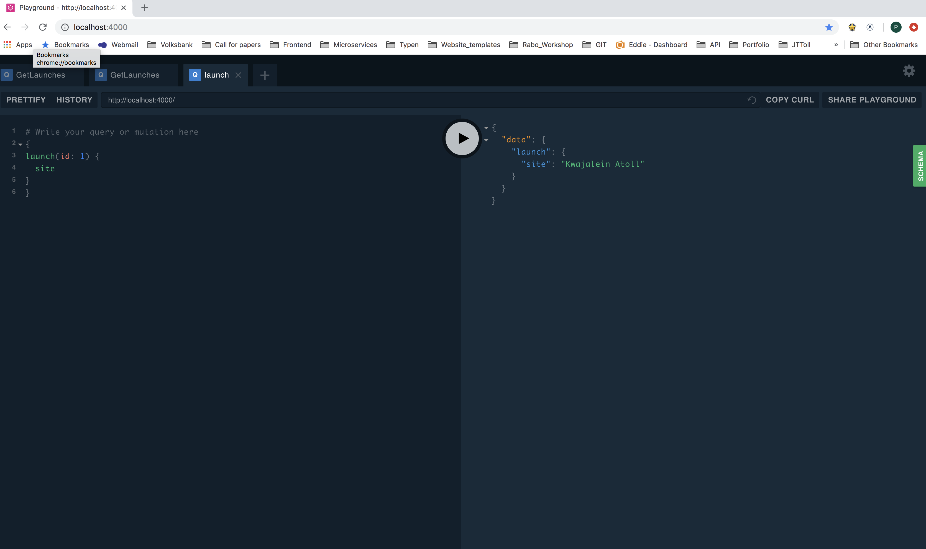
Test your schema in GraphQL Playground

Slide 30
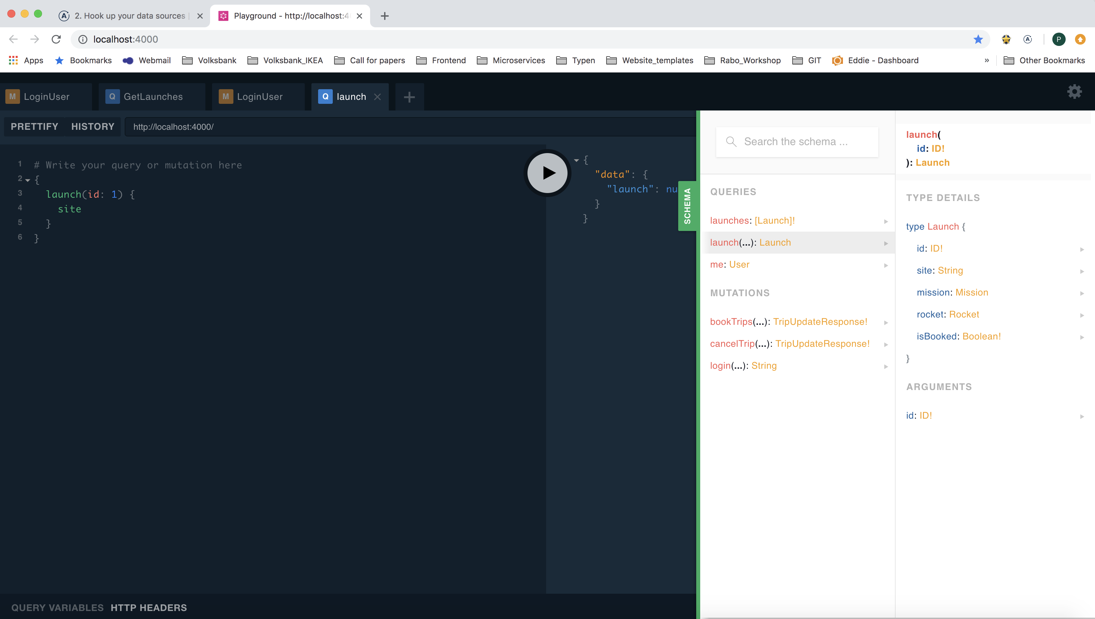
Test your schema in GraphQL Playground
Notes:
The Playground is an interactive, in-browser GraphQL IDE for exploring your schema and testing your queries.

Slide 31
Step 2: Hook up your data sources
Connect REST data to your graph/schema

Slide 32
Connect a REST API Data Source
First, let’s connect the Space-X v2 REST API to our schema.
Notes:
This package exposes the RESTDataSource class that is responsible for fetching data from a REST API and Caching.
To build a data source for a REST API, extend the RESTDataSource class and define this.baseURL.

Slide 33
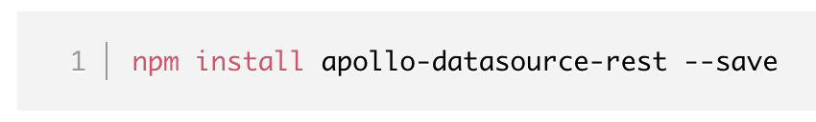
Connect a REST API Data Source
Install the apollo-datasource-restpackage:
Notes:
This package exposes the RESTDataSource class that is responsible for fetching data from a REST API and Caching.
To build a data source for a REST API, extend the RESTDataSource class and define this.baseURL.

Slide 34
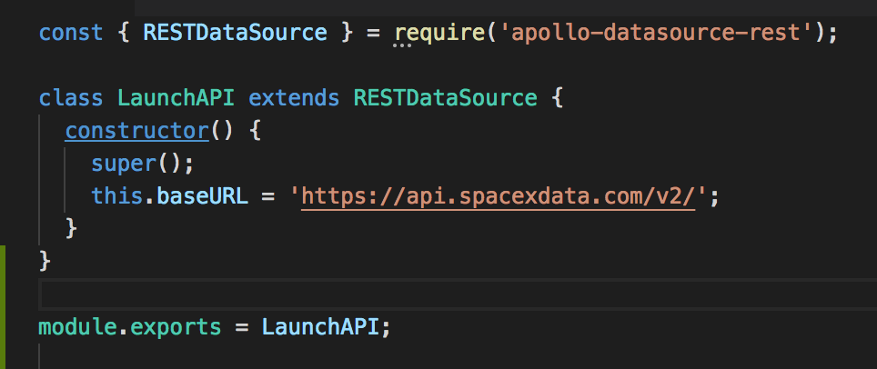
Define DataSource (launch.js)

Slide 35
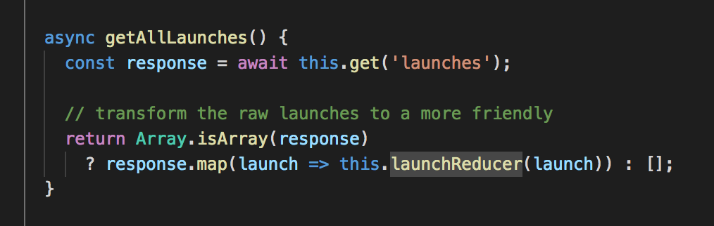
launch.js
this = the REST data sources with baseURL
https://api.spacexdata.com/v2/launches
Notes:
this = the REST data sources
The Apollo REST data sources has helper methods that correspond to HTTP verbs like GET and POST.
In the code above, this.get('launches'), makes a GET request to https://api.spacexdata.com/v2/launches and stores the returned launches in the response variable.
Then, the getAllLaunches method maps over the launches and transforms the response from our REST endpoint with this.launchReducer.

Slide 36
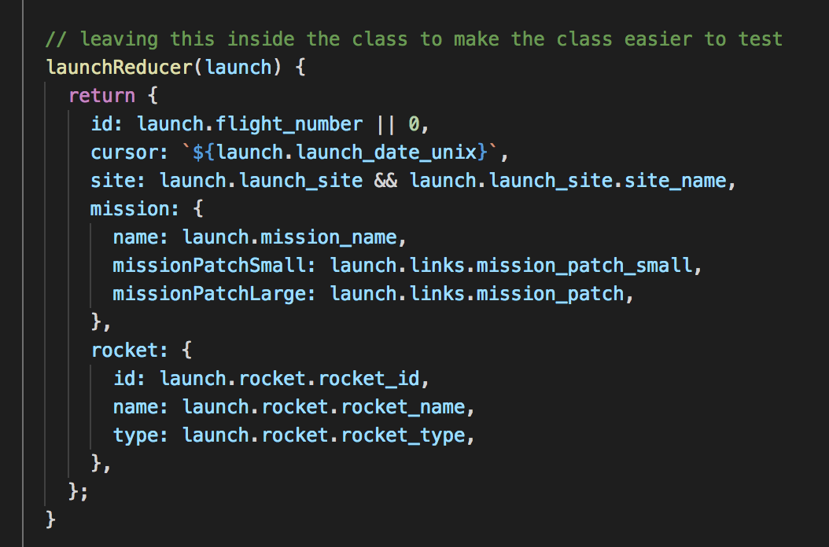
Add launchReducer in launch.js
Notes:
Now, we need to write our launchReducer method in order to transform our launch data into the shape our schema expects.

Slide 37
schema.js
Notes:
What’s awesome about GraphQL is that the shape of your query will match the shape of your response.
A schema also defines what data we can fetch through queries
and what data we can update through mutations
Since all types in GraphQL are nullable by default, we need to add the ! to indicate that our query will always return data. Next, we define a query to fetch a launch by its ID. This query takes an argument of id and returns a single launch. Finally, we will add a me query to fetch the current user's data.

Slide 38
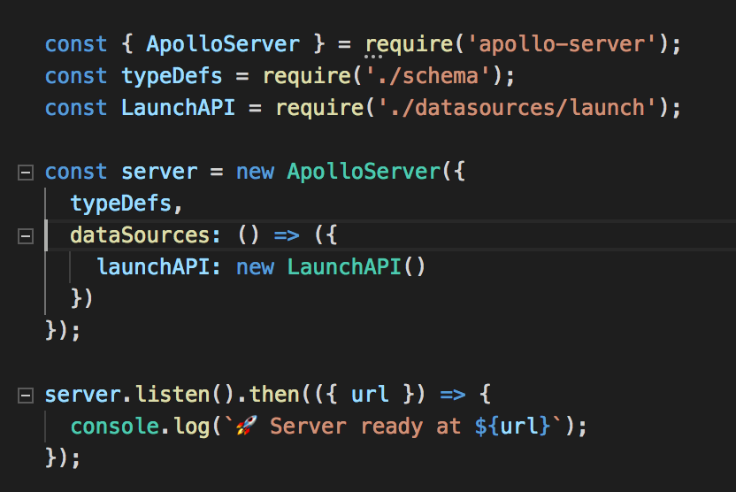
Add Datasource to Apollo Server (index.js)
Notes:
Data Source is in launch.js

Slide 39
Step 3: Write your graph’s Resolvers
Learn how a GraphQL query fetches data

Slide 40
What is a Resolver?
Resolvers voor het daadwerkelijk ophalen van de service.
Notes:
Resolvers provide the instructions for turning a GraphQL operation
(a query, mutation, or subscription) into data.

Slide 41
Syntax Resolver
Notes:
Resolver functions accept four arguments:
parent: An object that contains the result returned from the resolver on the parent type → always empty!
args: An object that contains the arguments passed to the field
context: We use the context to contain our data sources.
info: Information about the execution state of the operation which should only be used in advanced cases
Remember the LaunchAPI data source we created in the previous section and passed to the context property of ApolloServer? We're going to call them in our resolvers by accessing the context argument.

Slide 42
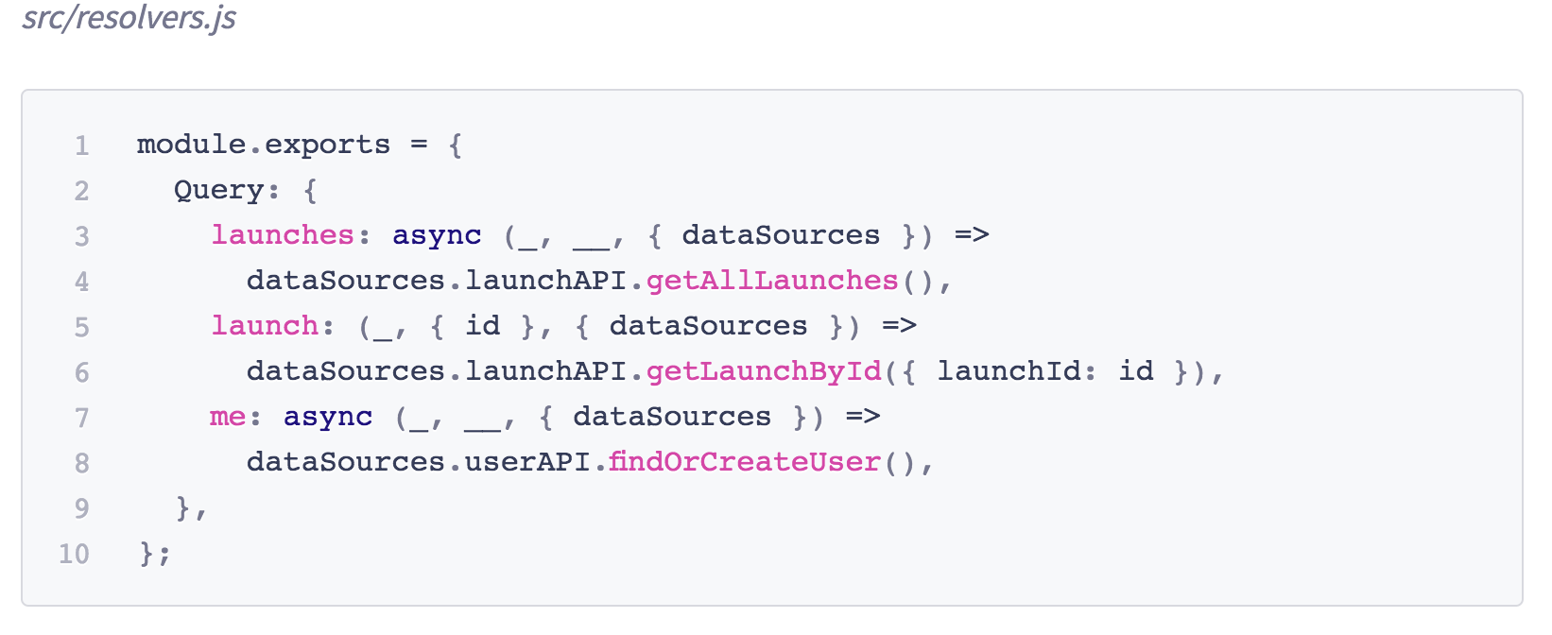
Write Query Resolvers (resolvers.js)
Notes:
The code above shows the resolver functions for the Query type fields: launches, launch, and me.
The first argument to our resolvers, parent, is always blank because it refers to the root of our graph.
The second argument refers to any arguments passed into our query, which we use in our launchquery to fetch a launch by its id.
Finally, we destructure our data sources off the third argument, context, in order to call them in our resolvers.

Slide 43
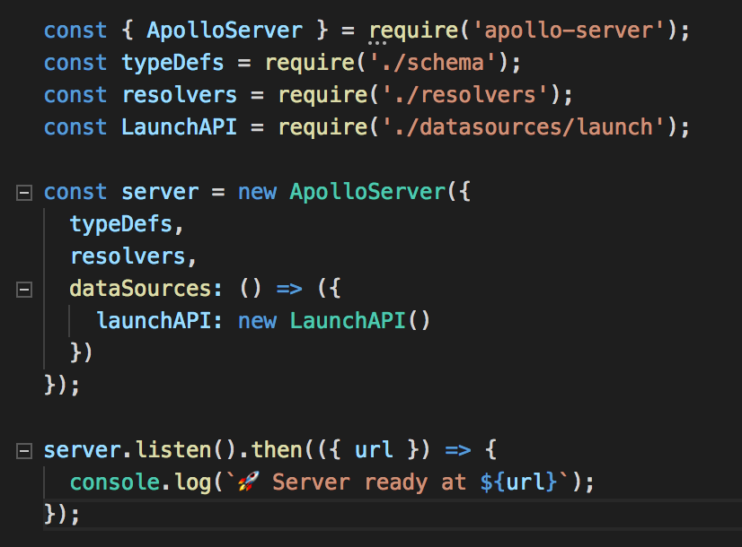
Connecting Resolvers to Apollo Server

Slide 44
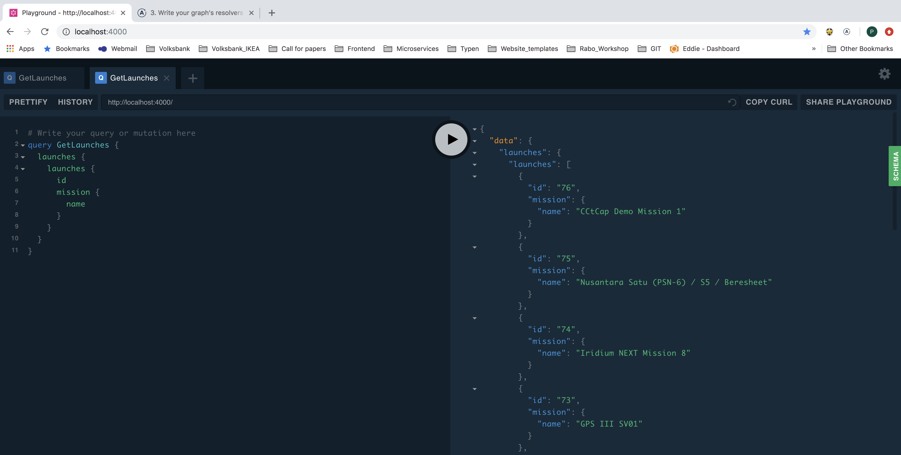
Run Queries in GraphQL Playground
Notes:
What's awesome about GraphQL is that the shape of your query will match the shape of your response.

Slide 45
Final flow
Resolver → Data Source → Reducer → Schema
→ FE
Notes:
Resolver roept de ‘Data Source’ aan voor het connecten naar de API. →
Reducer (in order to transform our data into the shape our schema ) → schema → to Frontend

Slide 46
Start Tutorial
https://www.apollographql.com/docs/tutorial/schema.html
Skip step 4: “Run your graph in production”

Slide 47
Instructions
There are two folders: one for the starting point (start/) and one for the final version (final).
Within each directory are two folders: one for the server and one for the client.
We will be working in the server folder first.

